Slide 1
Deep Reinforcement Learning
Summer Training Project
Saksham Gupta(CO16349)

Slide 2
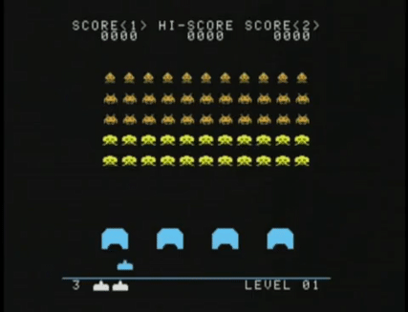
1980

Slide 3
We have come a long way since then
We today we will explore the advancements we have achieved so far.

Slide 4
Some Background Knowledge First
Machine Learning
Artificial Neural Networks
Reinforcement Learning
Actor Critic Methods

Slide 5
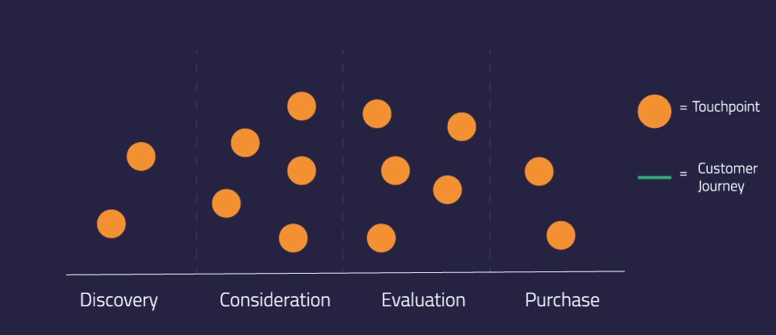
Machine Learning

Slide 6
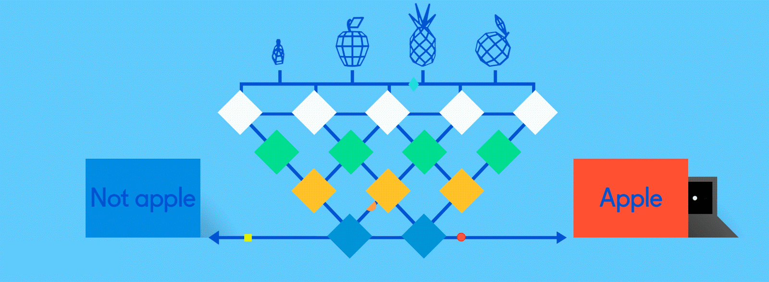
Artificial Neural Network

Slide 7
Reinforcement Learning
A robot takes a big step forward, then falls. The next time, it takes a smaller step and is able to hold its balance. The robot tries variations like this many times; eventually, it learns the right size of steps to take and walks steadily. It has succeeded.
What we see here is called reinforcement learning. Reinforcement learning, in a simplistic definition, is learning best actions based on reward or punishment.There are three basic concepts in reinforcement learning: state, action, and reward.
Reinforcement Learning is learning what to do and how to map situations to actions. The end result is to maximize the numerical reward signal. The learner is not told which action to take, but instead must discover which action will yield the maximum reward

Slide 8
Basic Concept
There are three basic concepts in reinforcement learning: state, action, and reward.
Action is what an agent can do in each state.The term “reward” is an abstract concept that describes feedback from the environment. A reward can be positive or negative. When the reward is positive, it is corresponding to our normal meaning of reward. When the reward is negative, it is corresponding to what we usually call “punishment.”
Once we know the state, we choose an action that (hopefully) leads to positive reward.
While neural networks are responsible for recent breakthroughs in problems like computer vision, machine translation and time series prediction – they can also combine with reinforcement learning algorithms to create something astounding

Slide 9
Some Key Terms
Discount factor: The discount factor is multiplied by future rewards as discovered by the agent in order to dampen thse rewards’ effect on the agent’s choice of action.
Policy (π): The policy is the strategy that the agent employs to determine the next action based on the current state. It maps states to actions, the actions that promise the highest reward.
Value (V): The expected long-term return with discount, as opposed to the short-term reward R.
Q-value or action-value (Q): Q-value is similar to Value, except that it takes an extra parameter, the current action a. Qπ(s, a) refers to the long-term return of the current state s, taking action a under policy π.

Slide 10
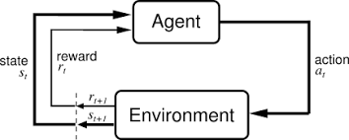
An Agent

Slide 11
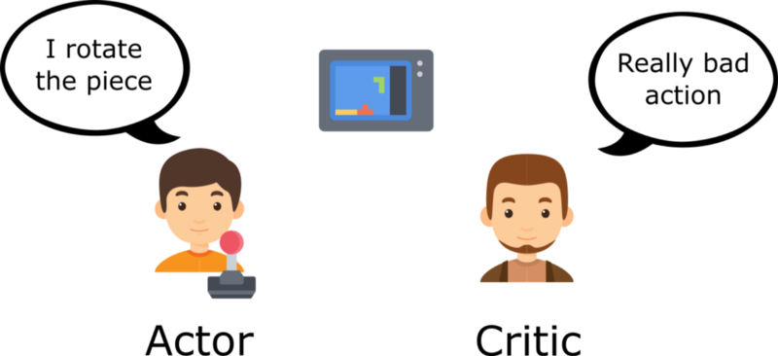
Actor Critic Methods
Imagine you play a video game with a friend that provides you some feedback. You’re the Actor and your friend is the Critic.At the beginning, you don’t know how to play, so you try some action randomly. The Critic observes your action and provides feedback. Learning from this feedback, you’ll update your policy and be better at playing that game. On the other hand, your friend (Critic) will also update their own way to provide feedback so it can be better next time.

Slide 12
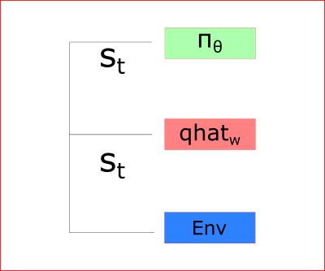
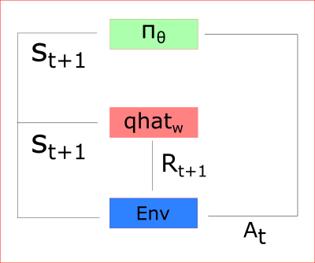
How Actor Critic Functions
Thus we’ll using two neural networks:
a Critic that measures how good the action taken is (value-based)
an Actor that controls how our agent behaves (policy-based)

Slide 13
A3C
Asynchronous Advantage Actor-Critic is quite a mouthful. Let’s start by unpacking the name, and from there, begin to unpack the mechanics of the algorithm itself.
Asynchronous: Unlike DQN, where a single agent represented by a single neural network interacts with a single environment, A3C utilizes multiple incarnations of the above in order to learn more efficiently. In A3C there is a global network, and multiple worker agents which each have their own set of network parameters. Each of these agents interacts with it’s own copy of the environment at the same time as the other agents are interacting with their environments.

Slide 14
A3C
Advantage: The insight of using advantage estimates rather than just discounted returns is to allow the agent to determine not just how good its actions were, but how much better they turned out to be than expected. Intuitively, this allows the algorithm to focus on where the network’s predictions were lacking
Actor-Critic:the agent uses the value estimate (the critic) to update the policy (the actor) more intelligently than traditional policy gradient methods.

Slide 15
How A3C Works
The A3C algorithm begins by constructing the global network. This network will consist of convolutional layers to process spatial dependencies, followed by an LSTM layer to process temporal dependencies, and finally, value and policy output layers.
Next, a set of worker agents, each with their own network and environment are created. Each of these workers are run on a separate processor thread
Each worker then interacts with its own copy of the environment and collects experience.
Once the worker’s experience history is large enough, we use it to determine discounted return and advantage, and use those to calculate value and policy losses.

Slide 16
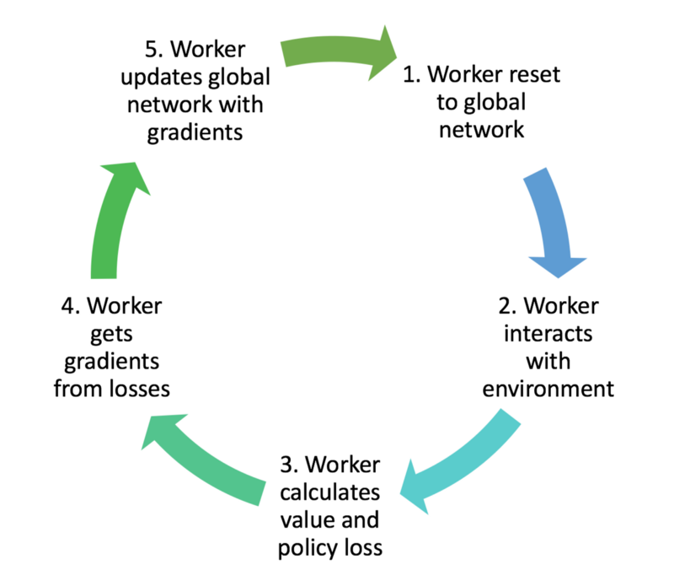
A3C Cycle

Slide 17
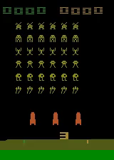
Initial Attempt

Slide 18
Implementation
To implement Our code we use 5 modules or files:-
Model.py: Here we define the brain of our model, i.e the Neural Networks.We define a class ActorCritic, which contains all the convulational and LSTM layer. It contains two functions init (to initialize the class) and forward(to propogate through our network)
shared_optim.py:This file contains the shared Adam Optimzer. It contains the class SharedAdam to create an adam optimizer with shared states

Slide 19
Implementation
3.envs.py: This file manages our Gym environments. Also here we manage how many videos are recorded.The function create_atari_env creates an ATARI environment and function _process_frame42 resizes the frame.
4. train.py: This file trains our AI.It contains a function ensure_shared_grads to make sure that the models share the same gradient, whereas the function train is used to train the model, and decide rewards and states, and determining the policy

Slide 20
Implementation
5. Test.py: This is used to run the agents on our environments, and calculates the rewards and stores them in a csv file. The function function test, runs on the environments and calculates the total reward
6.main.py: This is the driver file.Here the environment is initiated , all the parameters such as learning rates are set, and processes are created

Slide 21
And Now...

Slide 22
Frostbite
The bottom two thirds of the screen are covered by a mass of water with four rows of ice blocks floating horizontally. The player moves by jumping from one row to another while trying to avoid various kinds of foes including crabs and birds. There are also fish which grant extra points.
Each time the player jumps on a piece of ice in a row its color changes from white to blue and the player gets an ice block in the Igloo on the shore.

Slide 23
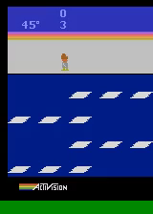
Frostbite

Slide 24
Applications of Deep Reinforcement Learning
1.Robotics and Industrial automation: A common example is the use of AI for tuning machines and equipment where expert human operators are currently being used.
2. Data Science and ML: AutoML from Google uses RL to produce state-of-the-art machine-generated neural network architectures for computer vision and language modeling.
3.Education and training: The use of Deep RL can lead to training systems that provide custom instruction and materials tuned to the needs of individual students

Slide 25
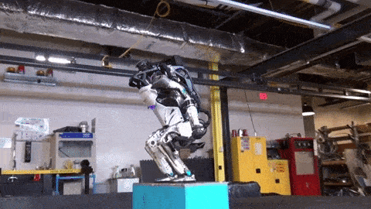
Applications of Reinforcement Learning
Using Deep RL, we can train robots using minimal codes. And by allowing themselves to explore all the situations

